Slide 1
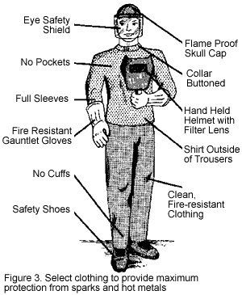
Safety in Welding Shop

